Slide 1
IMDb Data Exploration & Machine Learning
Katie Winkle
Women in Tech: Machine Learning Workshop Series

Slide 2
What could we predict?
IMDb data set included a huge range of features covering film details, actors & directors, financials etc.
Trying to predict IMDb score seemed too ‘obvious’
Decided on trying to predict the number of Facebook likes a film might receive
Social media massively relevant to modern day marketing & advertising
Some measure of pervasiveness/pervasiveness and therefore success

Slide 3
Where to start? Pre-processing the Data
Many 0 like entries, some of which definitely incorrect (e.g. Pirates of the Caribbean?!) so deleted all; ~2k data entries!
Facebook likes is a continuous scalar – so need to discretise under pre-defined labels
Wanted to assign ‘Low – Medium – High’ labels based on relative number of likes (bottom 25% = low, top 25% = high)
Applying directly to facebook likes didn’t work – ended up with too many films in the ‘medium’ category
Instead ranked films based on facebook likes and applied labels based on those rankings

Slide 4
Ready for a first run Quantitative Only Full Feature Set KNN
Minimum data manipulation for building a KNN classifier:
0 Facebook like data entries removed
Facebook like Low/Medium/High labels created
All qualitative data dismissed – KNN requires numbers!
Used sklearn to scale/split data and train KNN just as in class
Achieved a prediction accuracy of 54.8% on the training data

Slide 5
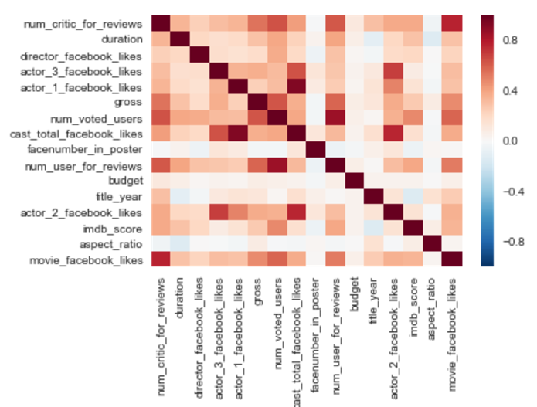
What’s really relevant? Data Exploration & Visualisation
Heatmap based on correlation matrix using pandas df.corr()
Picked out variables with correlation >= 0.5 (0.499 for gross)
Satisfying reflections:
Number of critic reviews strongest correlation
IMDb users like movies on Facebook?
Some correlation with gross
Not linked to actor/director Facebook likes
Improved KNN classifier with 60.4% accuracy

Slide 6
What about the text data we ignored? Data Exploration & Visualisation
Example: is genre relevant?
Pre-processing:
Multiple genres per film – treated as ‘tags’ rather than primary genre
Python scripting for splitting genre list in CSV, counting etc.
Satisfying reflections:
Documentaries rarely labelled as high, most Sci-Fi films medium/high – Facebook user demographics?

Slide 7
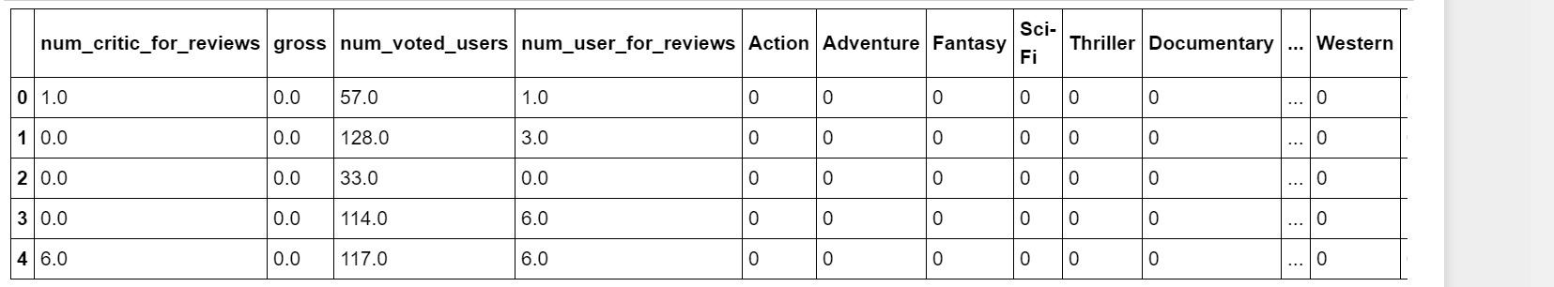
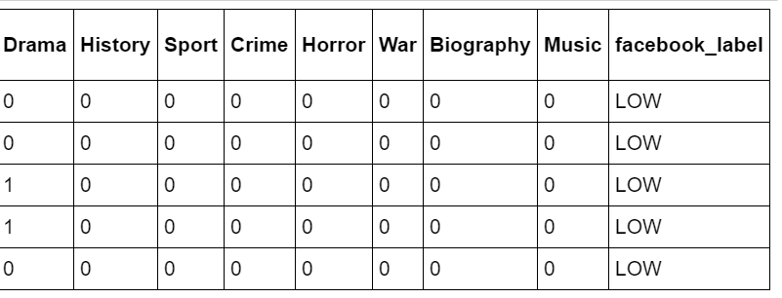
How to deal with text? Coding Qualitative Data
Example workaround for genres: binary classification
Does it have the action ‘tag’?
Not full solution (depends on number of possibilities e.g. language vs directors)
Addition of all genre data reduced classifier accuracy to 59.8%
Genres with one label >50% pushed accuracy up to 61.2%
Higher than what we achieved with the quantitative data alone

Slide 8
How good really is it? Comparing to ‘Chance’
Pure classifier accuracy isn’t always enough
Breast cancer recurrence: always predicting no would be 70% accurate¹
In the Facebook like case, always guessing ‘Medium’ would be ~50% accurate
Initially caught us out, you would expect ‘chance’ to be 33% as 3 possible labels
¹http://machinelearningmastery.com/classification-accuracy-is-not-enough-more-performance-measures-you-can-use/

Slide 9
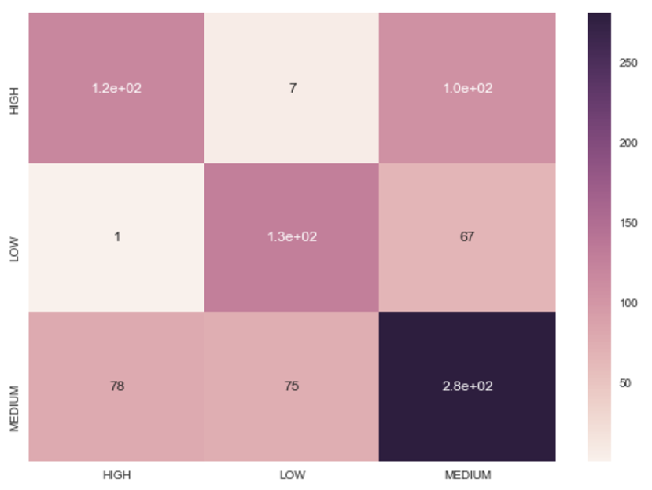
How else can we check? Confusion Matrix
Shows misclassifications by label
‘Satisfying’ (?) Reflections:
High & low rarely confused
Medium more often confused with high than with low
Most often correct on medium films -> reflection of data set as discussed prev?

